Slide 1
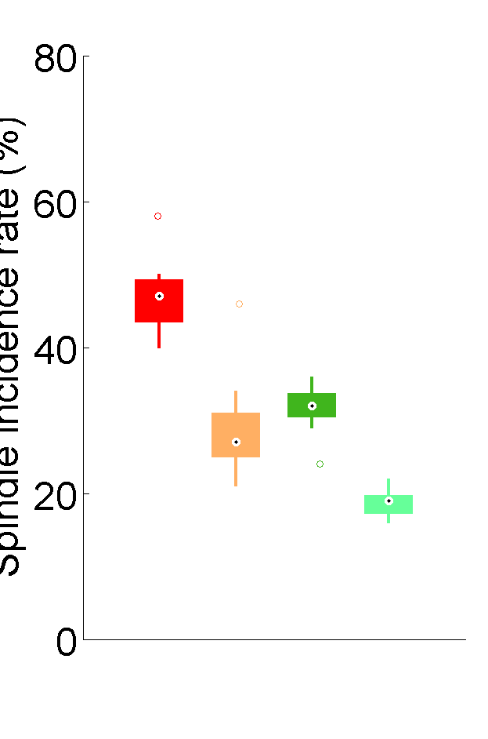
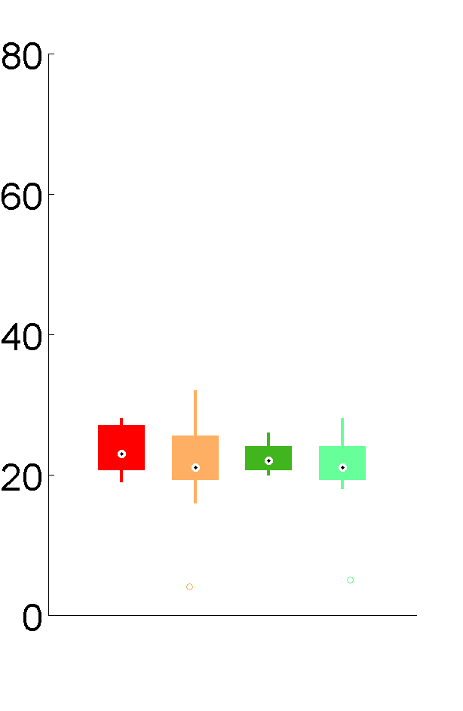
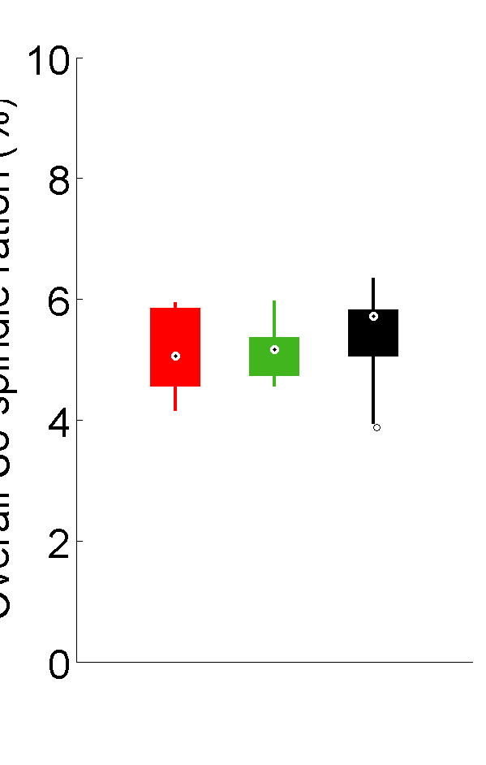
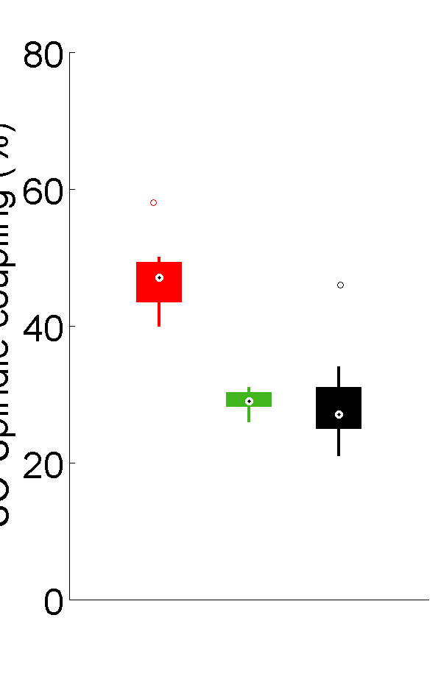
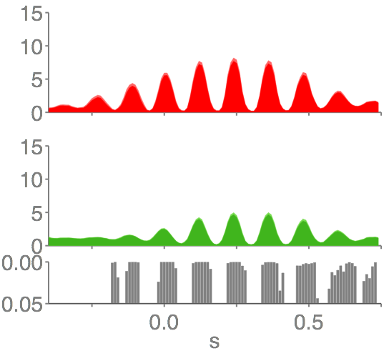
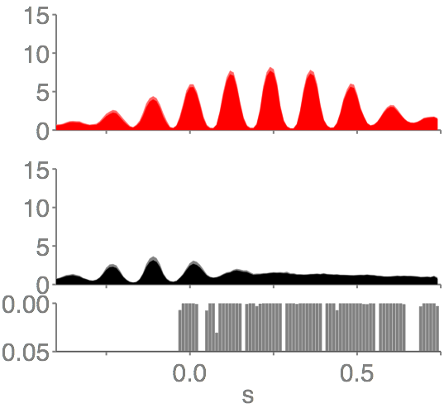
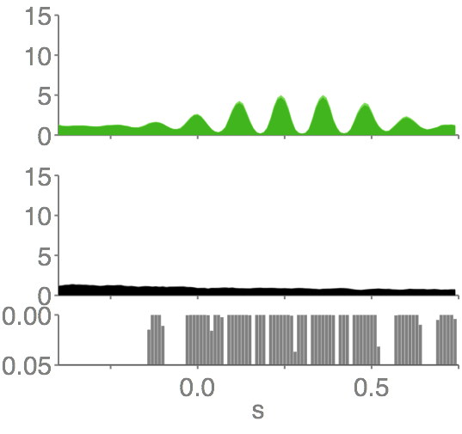
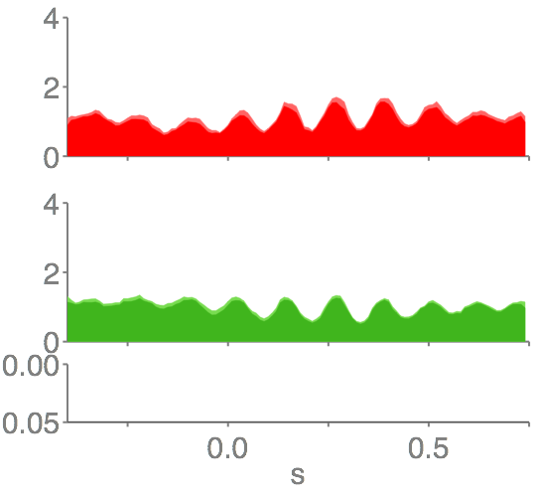
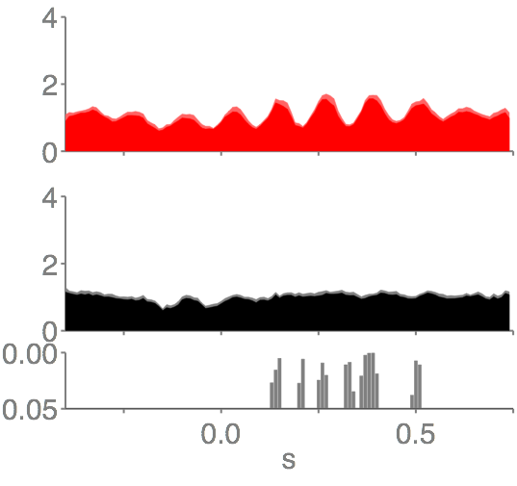
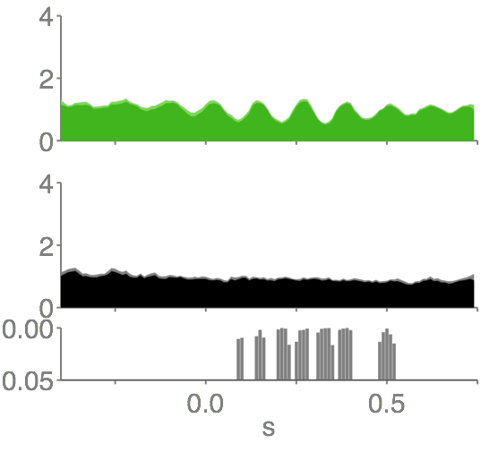
A
FRO
CA1
B
FRO
C
FRO
**
***
***
***
Overall Slow Oscillation to Spindle ratio (%)
Spindle incidence
rate (%)
On-line detected SO
coupled with spindles (%)
***
**
IN
NoSTIM-IN
IN
OUT
NoSTIM
OUT
NoSTIM-OUT
D
Stimulation-Spindle trough event-correlation
IN
IN
OUT
FRO
Spindle trough
density (%)
OUT
NoSTIM-IN
NoSTIM-OUT
P
Spindle trough
density (%)
CA1
P

